Slide 1
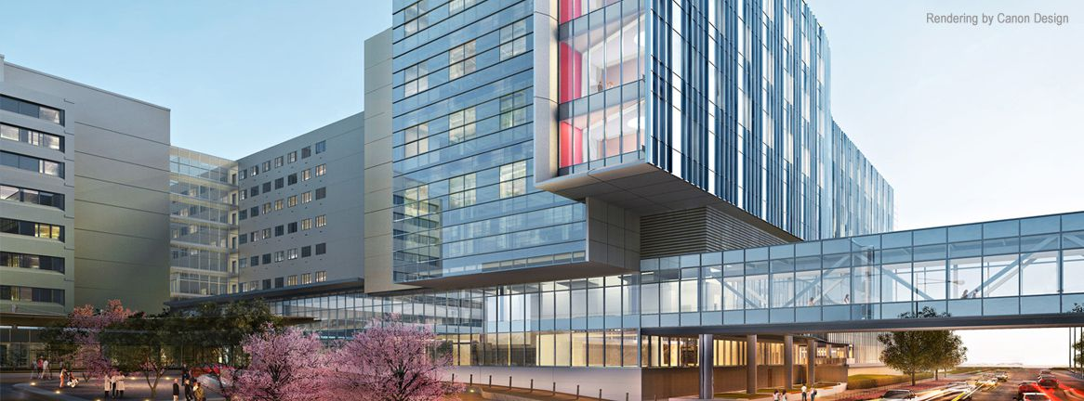
Background
Case
Discussion
References
(
(

